Slide 1

Attention-enhanced U-net autoencoder for low-dose CT simulation and lung nodule malignancy assessment
Author: Reza Gonabadi
Professor: Luca Mainardi
Co-advisor : Jiaying Liu
Academic Year : 2024-2025

Slide 2
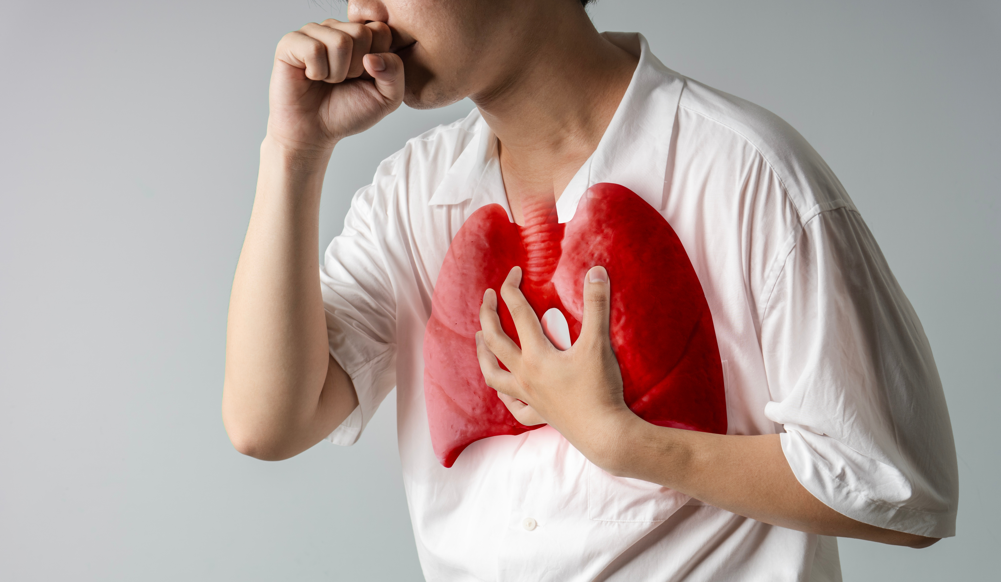
Introduction Lung cancer
1
Metric | Value | Source
New lung cancer cases worldwide | ~2.48 M | WCRF
Lung cancer deaths worldwide | ~1.8 M | ACS
% of all cancer deaths from lung cancer | ~19% | ACS
5-year survival (Stage I) | >65% | Cancer Research UK
5-year survival (late stage) | <10% | Cancer Research UK

Slide 3
Motivations & Problems
2
Radiation risks of full-dose CT (FDCT)

Slide 4
Motivations & Problems
2
Radiation risks of full-dose CT (FDCT)
Limitations of low-dose CT (LDCT)

Slide 5
Motivations & Problems
2
Radiation risks of full-dose CT (FDCT)
Limitations of low-dose CT (LDCT)
Clinical importance of accurate lung nodule classification

Slide 6
Motivations & Problems
2
Radiation risks of full-dose CT (FDCT)
Limitations of low-dose CT (LDCT)
Insufficient annotated LDCT datasets
Clinical importance of accurate lung nodule classification

Slide 7



Objectives
3
Simulate LDCT from FDCT
Extract radiomic features
Classify lung nodules malignancy

Slide 8
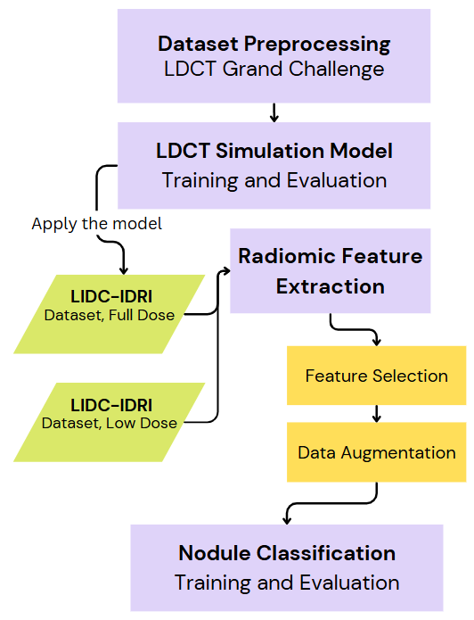
4
Methodology overview
LCDT Simulation
Feature Extraction
Nodule Classification

Slide 9
5
Datasets
Grand Challenge
LIDC-IDRI
Properties | SDCT | LDCT
Nr. participants | 694 | 316
Nr. nodules | 1950 | 675
Benign (avg. score < 4) | 1725 | 606
Malignant (avg. score >= 4) | 225 | 69
With Paired FD-LD Scans | 50
Slices per Subject | 250–350
Total Paired Slices | ∼16,500
85% for train
15% for test
Subjects with tube current ≤ 80 mA were reserved exclusively for the test set as true LDCT cases
All other subjects were used for training and validation, split 80% / 20%

Slide 10
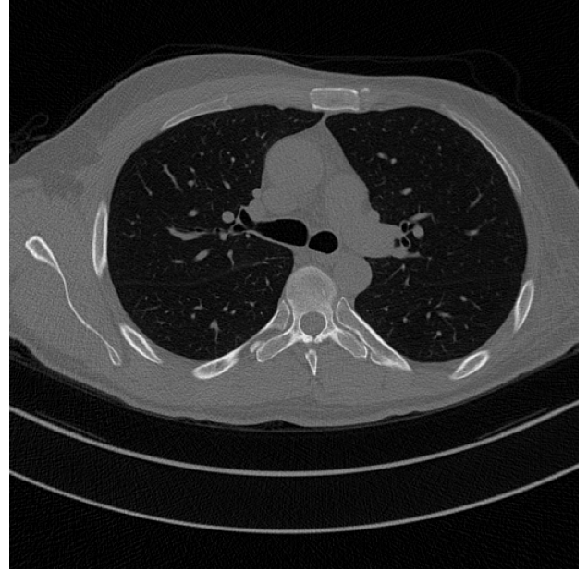
6
Preprocessing Slices
Binarized image using Otsu’s method.
Detected elongated artifacts in the lower third.
Removed them via binary mask.

Slide 11

7
Preprocessing Slices Result
Before
After

Slide 12
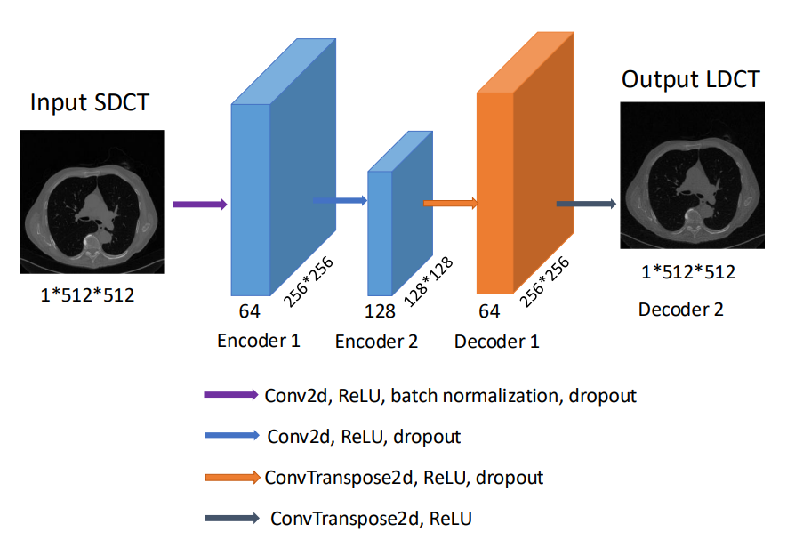
8
LDCT Simulation
Simple Autoencoder
Learn a compressed representation of FDCT and reconstruct an LDCT version.
Loss Function: Uses only Mean Absolute Error (MAE) → leads to pixel-wise similarity but ignores perceptual quality.

Slide 13
9
LDCT Simulation
Image Quality Metrics
SSIM – Structural Similarity Index
PSNR – Peak Signal-to-Noise Ratio
Measures pixel-wise accuracy between original and reconstructed images
Expressed in decibels (dB) → Closer to 30 dB or higher is considered good quality
Higher PSNR indicates lower error and better image fidelity
Measures perceptual similarity based on luminance, contrast, and structure
Values range from 0 to 1 → Closer to 1 is better
Reflects how structurally similar two images are

Slide 14
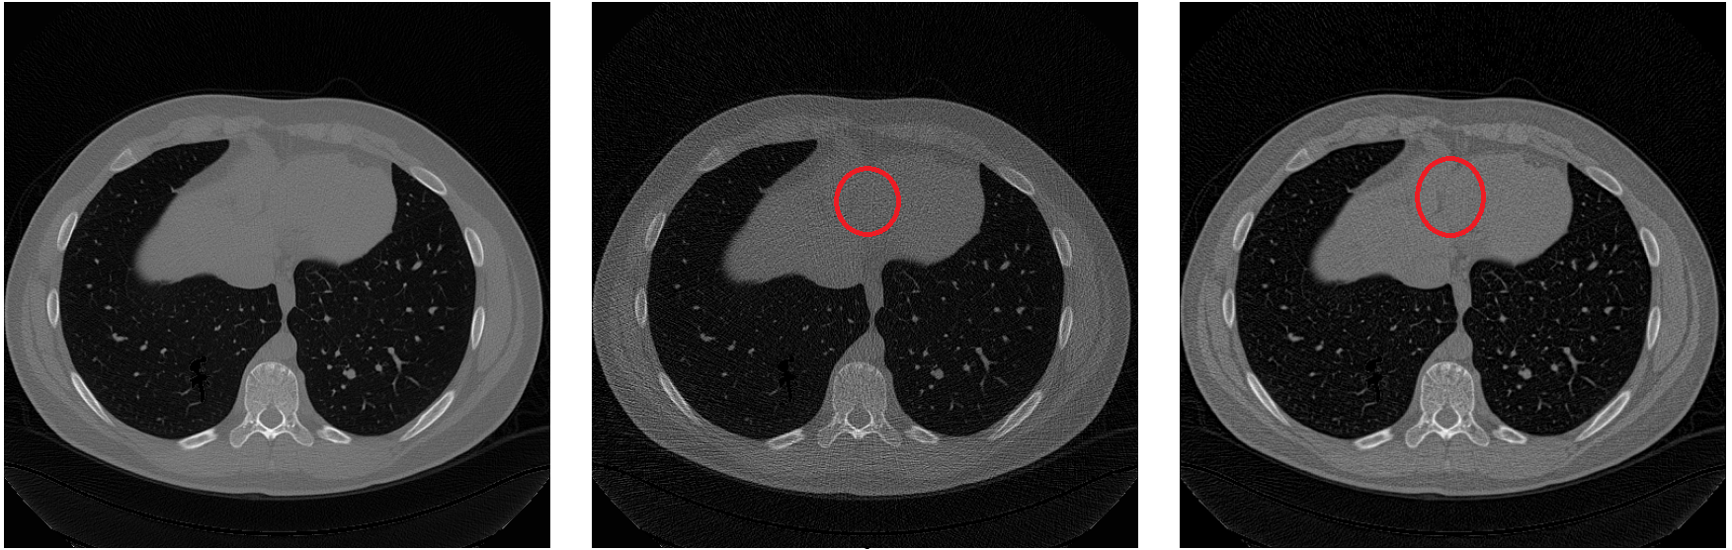
10
LDCT Simulation
Simple Autoencoder Performance
Performance:
PSNR: 23.50 dB
SSIM: 0.723
Tends to over-smooth anatomical details
Struggles to retain fine textures
True FD
True LD
Simulated LD

Slide 15
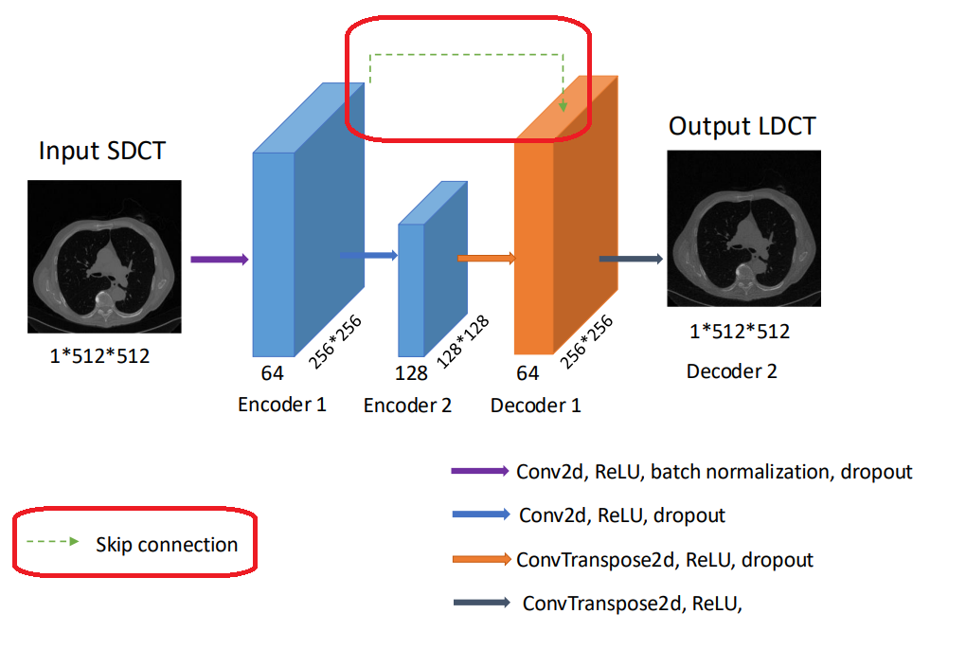
11
LDCT Simulation
Autoencoder with U-net
Improves anatomical detail reconstruction by bypassing encoder-to-decoder bottleneck
Allows high-resolution spatial features (e.g., edges, textures) to flow directly to the decoder
Helps preserve fine structural details critical for medical image quality
Loss Function: Combined MAE (30%) + SSIM (70%) which balances pixel accuracy and perceptual similarity.

Slide 16
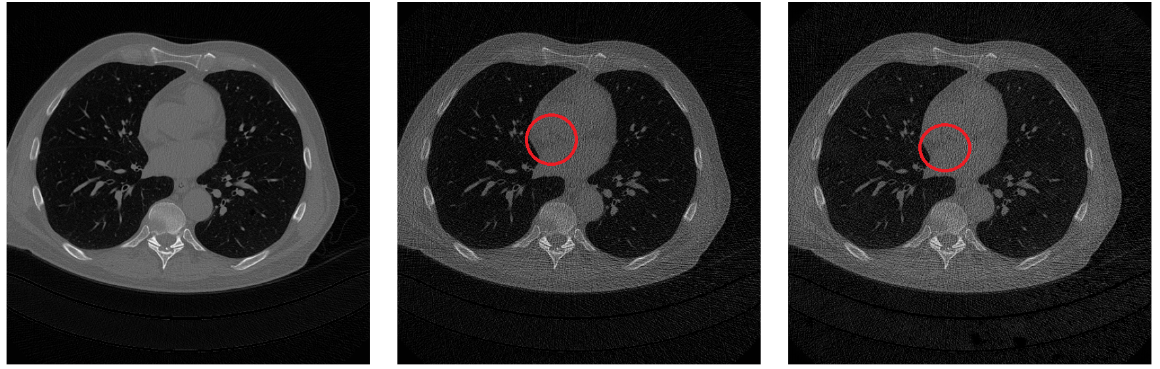
12
LDCT Simulation
Performance:
PSNR: 27.84 dB (↑4.34 dB)
SSIM: 0.888 (↑0.165)
Autoencoder with U-net Performance
True FD
True LD
Simulated LD

Slide 17
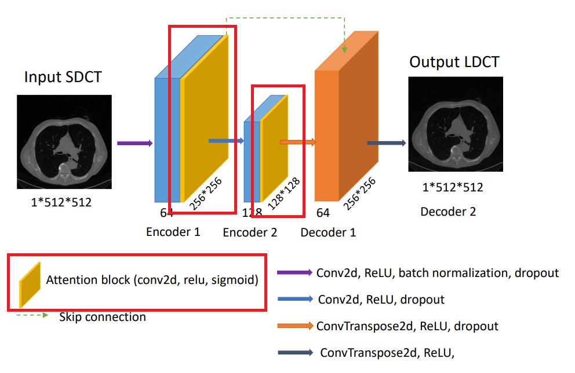
13
LDCT Simulation
Attention-Enhanced U-Net
Focus the model’s attention on informative regions (e.g., fine textures, nodules) and suppress irrelevant areas (e.g., noise, background).
Attention helps highlight subtle, clinically relevant features that might be lost.
Loss Function:
MAE: ↓ to 16%
SSIM: ↑ to 84% → More perceptual fidelity

Slide 18
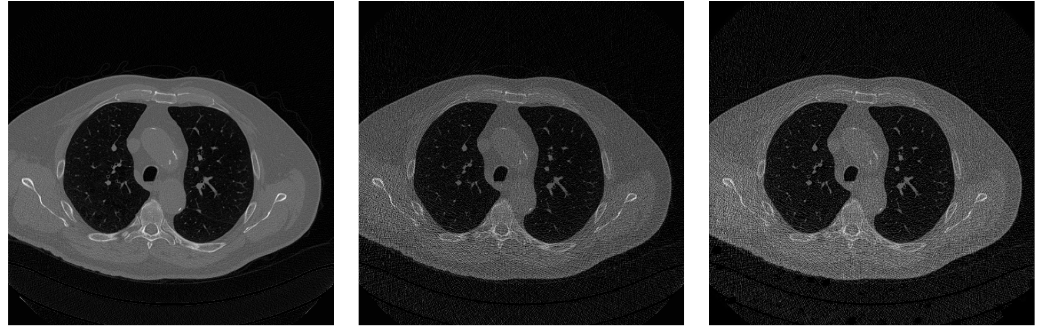
14
LDCT Simulation
Performance:
PSNR: 32.02 dB (↑4.18 dB)
SSIM: 0.9311 (↑0.043)
Attention-Enhanced U-Net
Performance
True FD
True LD
Simulated LD

Slide 19
15
LDCT Simulation
Final comparison
Architecture | PSNR (dB) | SSIM
Simple AE | 23.50 | 0.723
+ Skip Connections | 27.84 | 0.8881
+ Attention Mechanism | 32.02 | 0.9311
Image quality was also evaluated using the Noise Power Spectrum (NPS)
Achieved a normalized MAD of 0.0672, showing strong noise texture consistency
Falls within the typical literature range of 0.05–0.15 for LDCT realism(Naziroglu et al.*, 2017)
*Naziroglu, R. E., van Ravesteijn, V. F., van Vliet, L. J., Streekstra, G. J., & Vos, F. M. (2017). Simulation of scanner- and patient-specific low-dose CT imaging from existing CT images. Physica Medica, 36, 12–23.

Slide 20
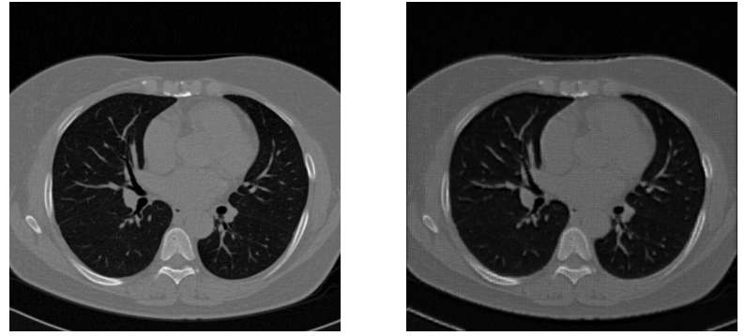
Nodule Classification
16
Malignancy Assesment
1
LIDC-IDRI Degradation
True FD
Simulated LD

Slide 21
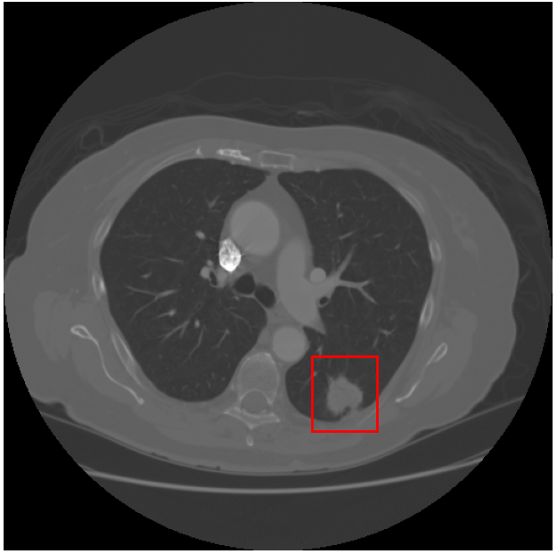
Nodule Classification
17
Malignancy Assesment
2
Radiomic Feature Extraction
Radiomics extracts detailed quantitative features, enabling precise and objective lung nodule analysis.
First-order
Shape and size
Texture
Wavelet

Slide 22
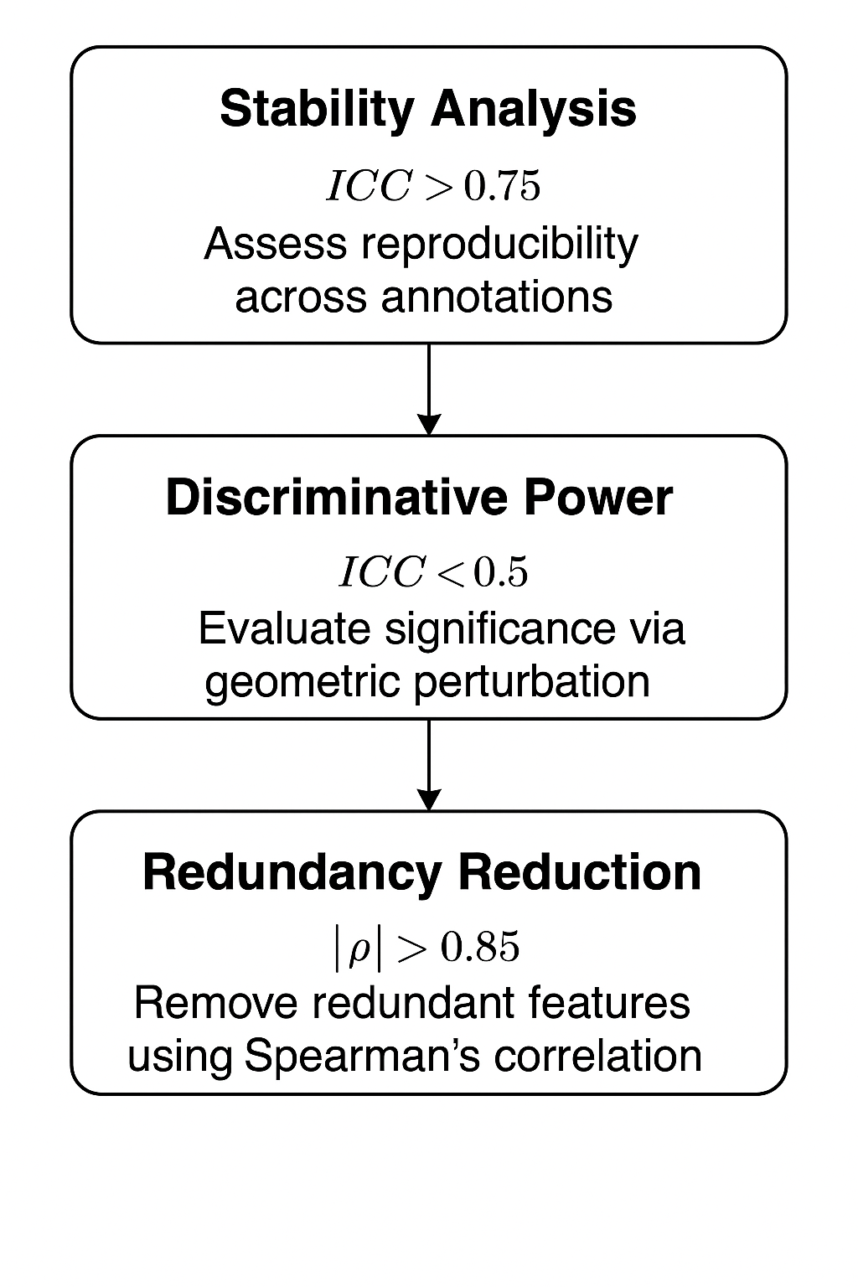
Nodule Classification
18
Malignancy Assesment
3
Feature Selection Process
Before Feature Selection | Number of features
All features | 851
No shape and size | 837
Only shape and size | 14
After Feature Selection | Number of features
All features | 79
No shape and size | 76
Only shape and size | 3

Slide 23
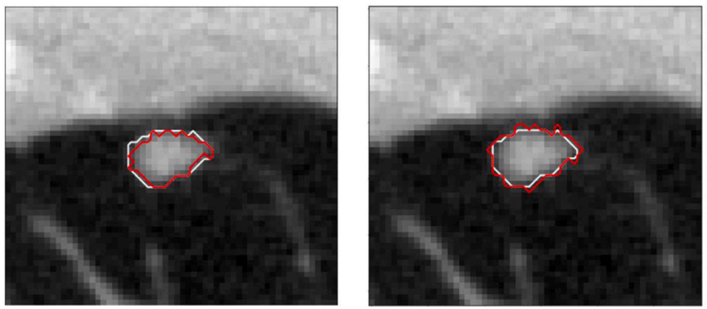
Nodule Classification
19
Malignancy Assesment
5
Data Augmentation
Morphological operations: Dilation and erosion to simulate segmentation variability
Noise injection: Salt-and-pepper and Gaussian blur to mimic annotation imperfections
Random contour deformations: Slight boundary changes for anatomical realism
Erosion
Dilation
 | Benign | Malignant
Before Augmentation | 1725 | 225
After Augmentation | 1725 | 1115

Slide 24


Nodule Classification
20
Malignancy Assesment
6
Model training and evaluation
Classifier
metrics
Random Forest
AdaBoost
XGBoost
Decision Tree
K-Nearest Neighbors
Logistic Regression
Multilayer Perceptron
Balanced Accuracy
Sensitivity
Specificity
ROC AUC
F1-score

Slide 25
Nodule Classification
21
Malignancy Assesment
7
Classification results
Feature Group | Top Model | Balanced Accuracy | AUC
Shape-only (3) | Logistic Regression | 80.0% | 0.839
Non-shape (76) | Adaboost | 78.3% | 0.807
All (79) | Random Forest | 79.2% | 0.831

Slide 26
Nodule Classification
22
Malignancy Assesment
7
Classification Comparision
Feature Group | Study | Balanced Accuracy | AUC
Shape-only (3) | This Study | 80.0% | 0.839
 | Liu et al*. | 80.5% | 0.874
Non-shape (76) | This Study | 78.3% | 0.807
 | Liu et al. | 66.4% | 0.822
All features (79) | This Study | 79.2% | 0.831
 | Liu et al. | 76.9% | 0.865
*Liu, J., Corti, A., Corino, V. D. A., & Mainardi, L. (2020). Lung nodule classification using radiomics model trained on degraded SDCT images.

Slide 27



LIMITATIONS & IMPROVEMENTS
23
Enhance Simulation with GANs & Physical parameters related to device
Increase sample size
Move Toward End-to-End Learning

Slide 28
Conclusion
24
Developed attention-enhanced U-net for LDCT simulation, achieving PSNR 32.02 dB and SSIM 0.9311, enhancing safe lung cancer detection.
Refined radiomic features enable nodule classification with up to 80% accuracy, reducing radiation risks and improving early diagnosis.

Slide 29
Thank you for your attention
Reza Gonabadi
Milan, 22/07/2025

